Slide 1

Recommender Systems
PyData Pune Nov | Nov 25th 2018
github.com/ankushtale/Presentations
Notes:
Disclaimer for simplicity

Slide 2
Agenda
What are Recommender Systems?
RecoSys around us
Types of RecoSys
Fundamentals
Code using Matrix Factorization
Code using Lightfm and Surpirse
Deep Learning in RecoSys
Notes:
Disclaimer: Abstraction
Aim of talk: Get you interested in the field

Slide 3
Machine Learning
P - Error
P - Error
90%
10%
Task T
Experience E
Task T
“A computer program is said to learn from Experience E to do a task T better,
measured by a performance metric P”
Notes:
Its just another function

Slide 4

Recommender Systems

Slide 5
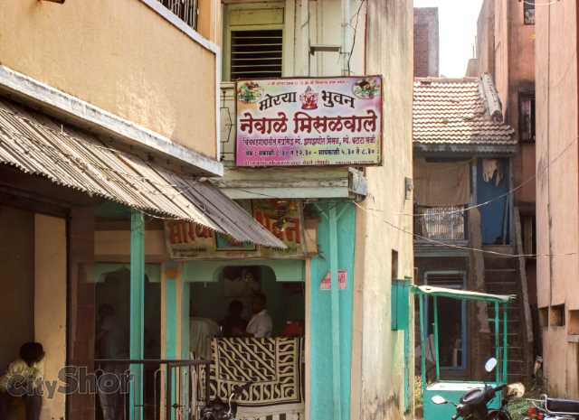
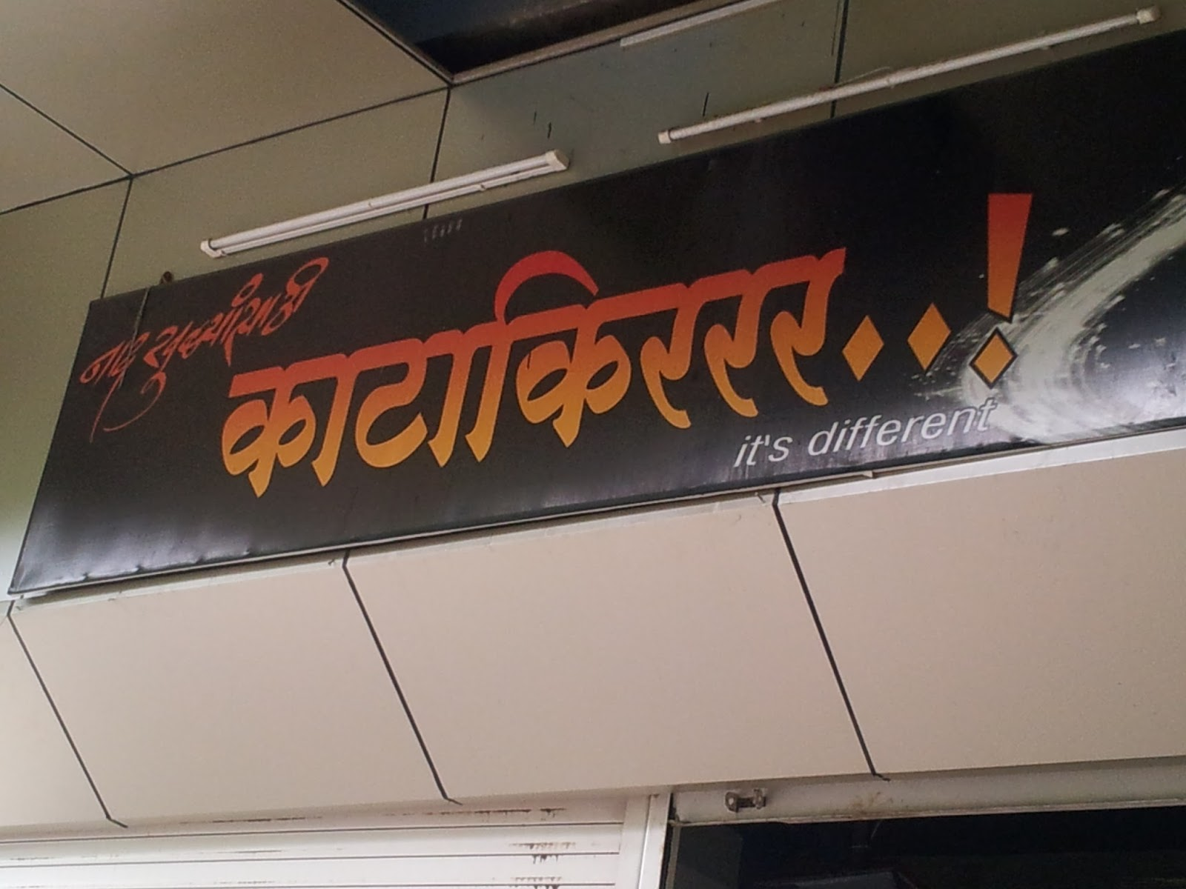
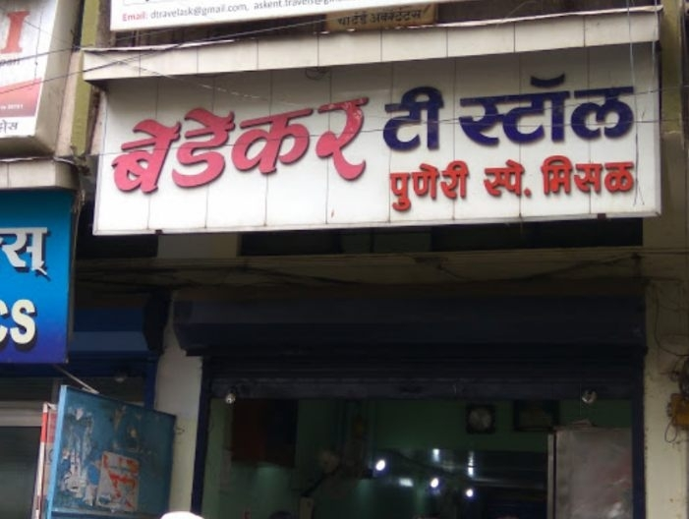
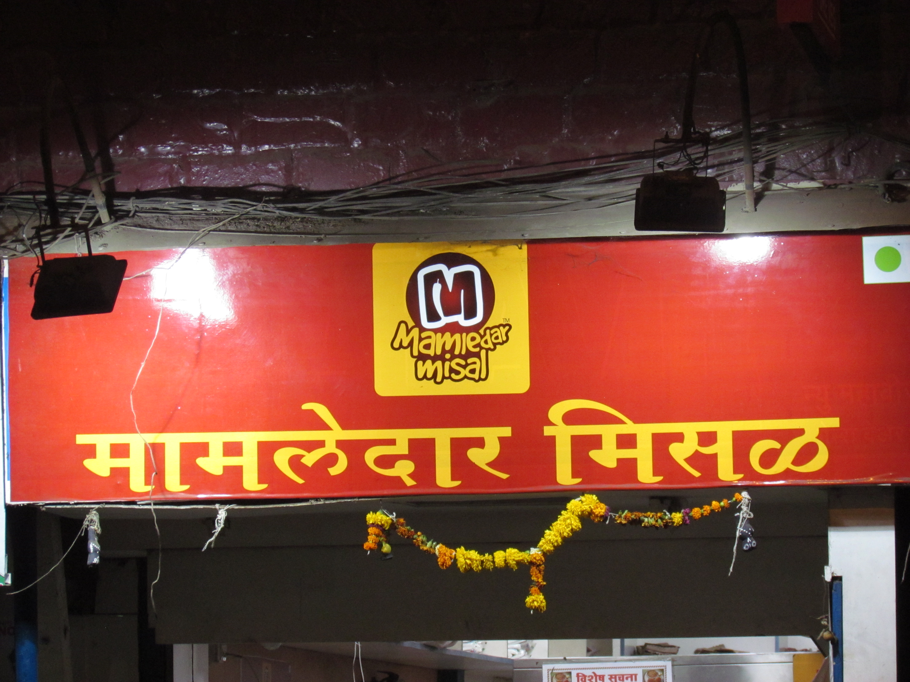
Best Misal in Pune?
New in Pune
Why?
How do you know that?

Slide 6

Life is full of choices
Small questions - school to attend, career to choose, city to settle in
Big questions - python or java, Laurel or Yanny
So are services and products
missal place to go, clothes to buy, videos to watch, meetup to attend
Decision Fatigue
We use willpower to do everything
Our daily willpower is limited
Relevance and User Level Personalization (marketing)
Notes:
Just Dial

Slide 7
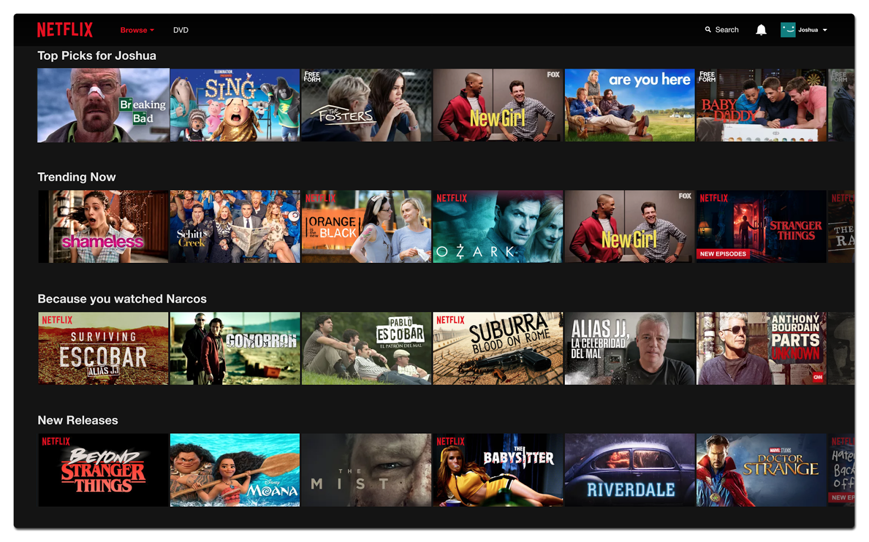
The way you chill

Slide 8


What you buy

Slide 9


Who you be-friend

Slide 10
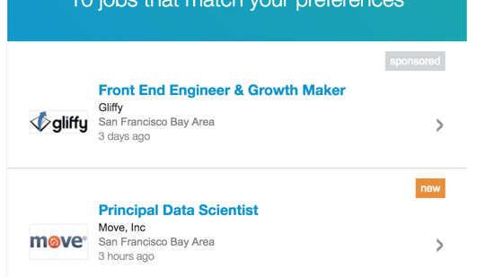
Where you work

Slide 11


Power of Recommendations
Published in 1988
Published in 1996

Slide 12


“Yesterday, I had half an hour of free time.”
“So instead of watching a movie, I spent half hour browsing for one”
- Albert Einstein
35% purchases you make on Amazon are influenced by recommendation systems
70% of videos that each user watches on YouTube is recommended by Google Recommendation Engine
75% of what people are watching on Netflix is recommended content

Slide 13
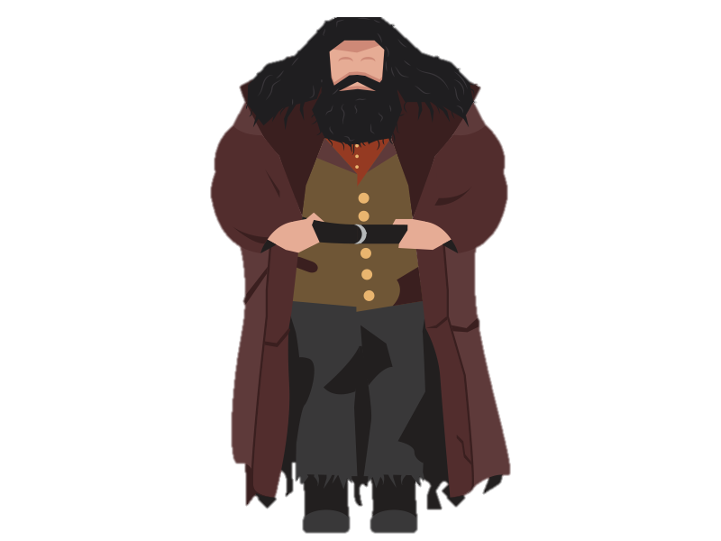

NEED TO KNOW
Notes:
Diagon alley

Slide 14

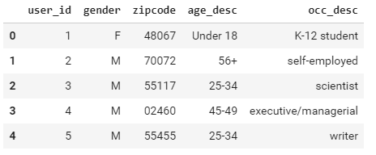

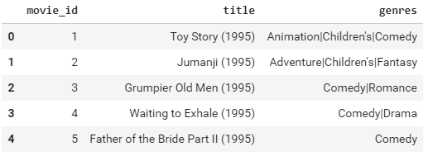
User Matrix Rating Matrix
User
Item

Slide 15
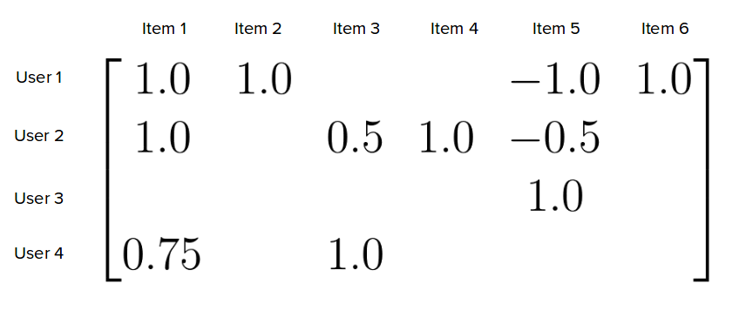




Rating Matrix
Interactions

Slide 16
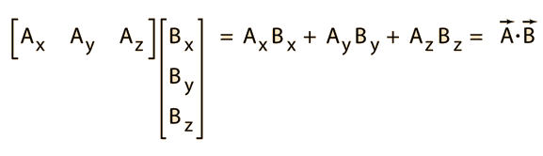
Dot Product

Slide 17
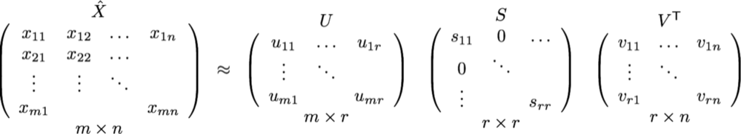
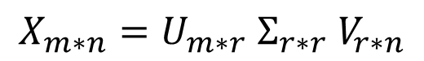
Singular Value Decomposition
$$X_{m∗n}=U_{m∗r} Σ_{r∗r} V_{r∗n}$$
Where r < m, n
Reconstructs larger matrix into product of 3 smaller matrices,
each is unique in its own way
Captures hidden/latent correlations in data

Slide 18
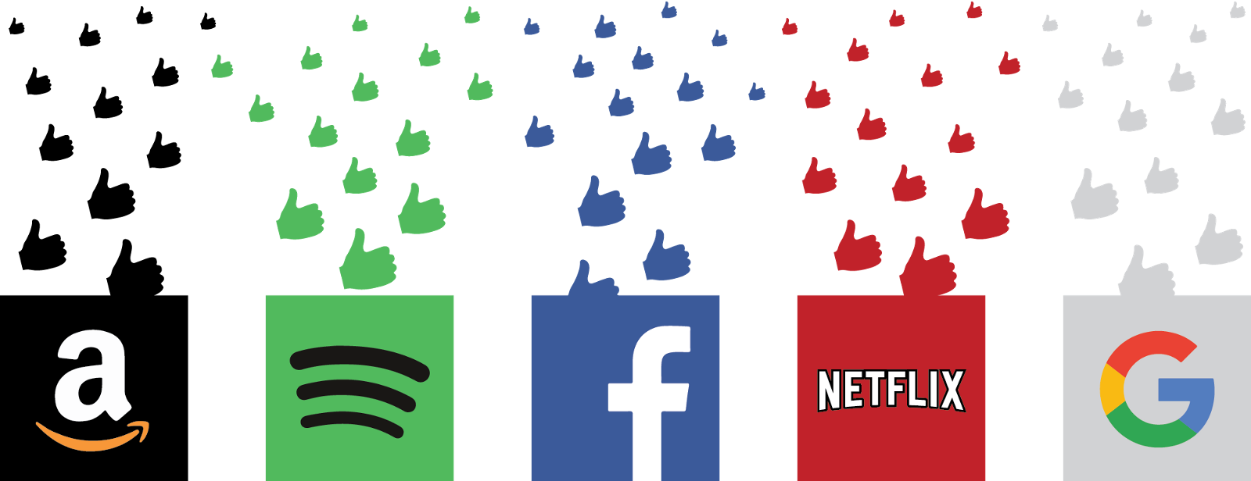
HOW IT WORKS ?
Notes:
Companies profile you and your habits

Slide 19
THREE MAJOR METHODOLOGY
Collaborative
Filtering
Content Based
Hybrid

Slide 20



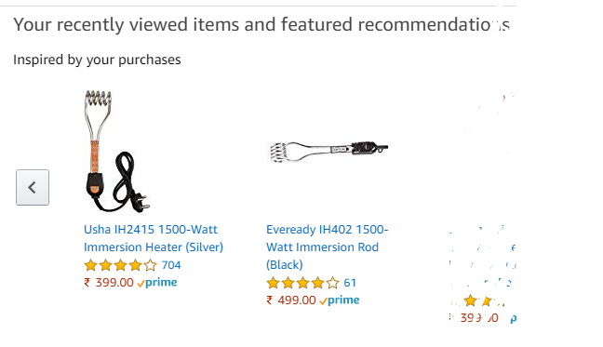
Content based filtering
The basic idea is: if you like an item then you’ll like a similar item
If you like Bedekar Misal, you would like Newale Misal as you like misal

Slide 21
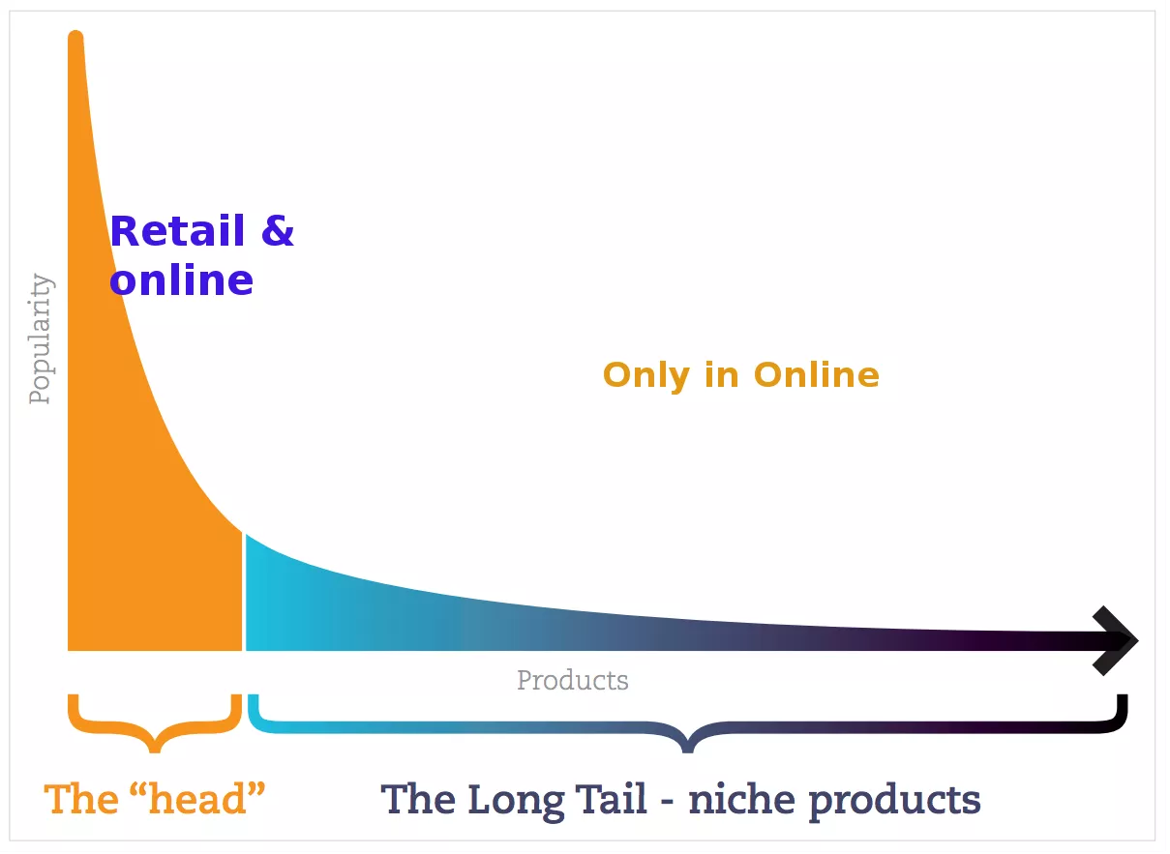
Type 0: Recommend most popular

Slide 22
Example : Content Based
 | Action | Comedy | Children’s
User 1 | 1 | 1 | 0
User 2 | 1 | 1 | 1
 | Action | Comedy | Children’s
Star Wars | 1 | 0 | 0
Jumanji | 1 | 1 | 1
Rush Hour | 1 | 1 | 0
Jungle Book | 1 | 1 | 1
The Hangover | 1 | 1 | 0
User Profile
Item Profile
User 2
Likes: Jumanji
Recommend: Jungle Book
Notes:
Write down equation

Slide 23
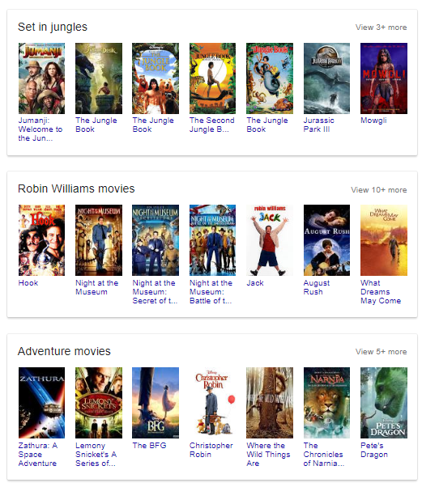
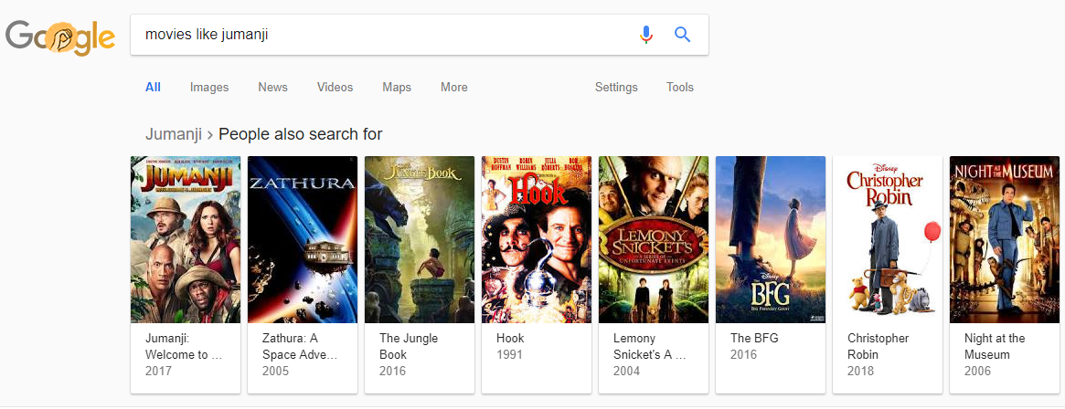

Slide 24
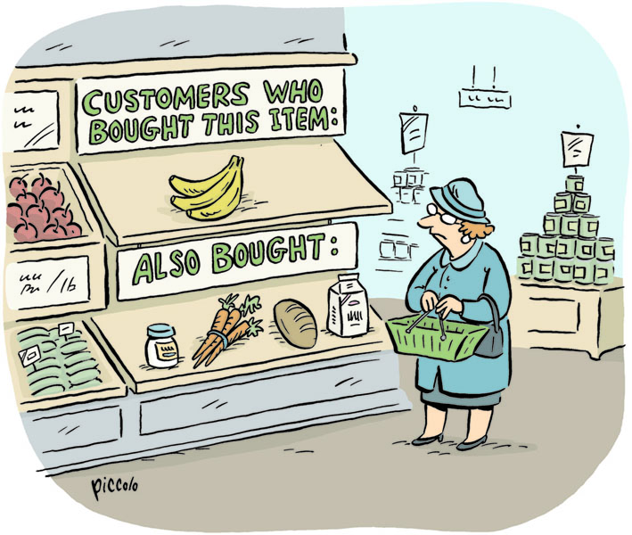
Collaborative Filtering
Based on the similarity in preferences, tastes and choices of two users.
It analyses how similar the tastes of one user is to another and makes recommendations on the basis of that.
Notes:
Virtual profiles of you

Slide 25
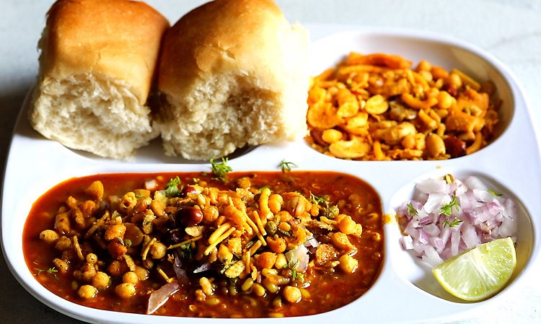

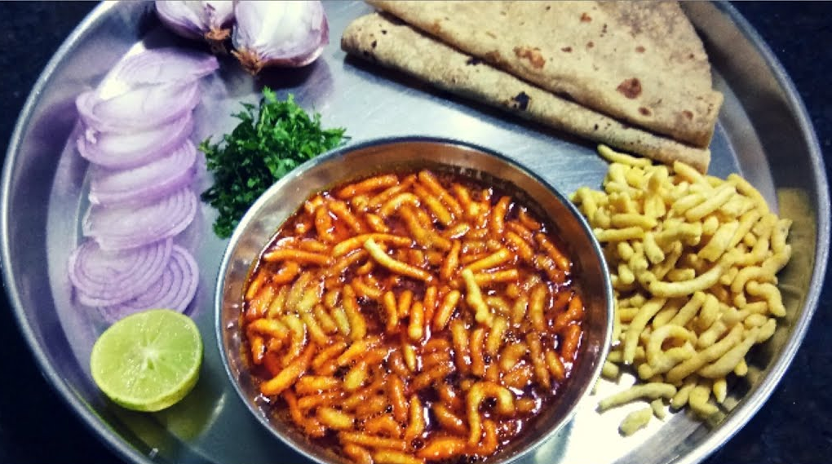
Collaborative Filtering
Latent features – Spicy, Pav based
Suresh
Paresh
?
?
Notes:
Virtual profiles of you

Slide 26
Example : Collaborative Filtering
 | Movie 1 | Movie 2 | Movie 3 | Movie 4 | Movie 5
User 1 | 2 | ? | 4 | 3
User 2 | 2 | 2 | 3 |  | 4
User 3 | 1 | 5 | 3 | 2
Ratings Matrix
*Cold Start problem

Slide 27
Ratings Matrix
 | Movie 1 | Movie 2 | Movie 3 | Movie 4 | Movie 5
User 1 | 2 | ? | 4 | 3
User 2 | 2 | 2 | 3 |  | 4
User 3 | 1 | 5 | 3 | 2
Goal: Predict the missing ratings and suggest the highest one to the User
In essence, goal is to capture latent relationships between users and movies

Slide 28
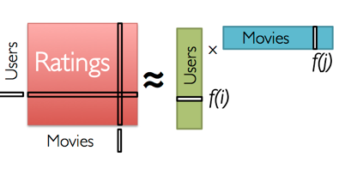
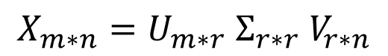
Ratings Matrix
 | Movie 1 | Movie 2 | Movie 3 | Movie 4 | Movie 5
User 1 | 2 | ? | 4 | 3
User 2 | 2 | 2 | 3 |  | 4
User 3 | 1 | 5 | 3 | 2
Training: Use Matrix factorization approaches (Eg. Singular value Decomposition or SVD) to split the Rating Matrix into constituent User Matrix and Item Matrix with minimum Sum of squared error (SSE).
Rating Matrix
$$X_{m∗n}=U_{m∗r} Σ_{r∗r} V_{r∗n}$$

Slide 29
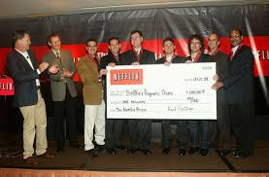
Ratings Matrix
 | Movie 1 | Movie 2 | Movie 3 | Movie 4 | Movie 5
User 1 | 2 | ? | 4 | 3
User 2 | 2 | 2 | 3 |  | 4
User 3 | 1 | 5 | 3 | 2
Rating Matrix of size 480,189 x 17,770 and sparse in nature (91.5%)
Million Dollar Question!
Netflix Prize 2009 (Performance gain of 10.4%)
Winner used various SVD models of Collaborative Filtering
(SVD++ blended with Restricted Boltzmann Machines)

Slide 30

Recap

Slide 31
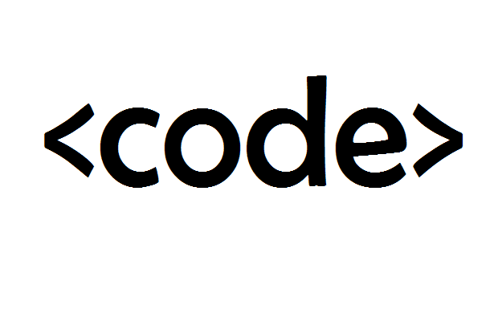
Demo time!

Slide 32


Performance Metrics
All Recommendations (made on training dataset)
Relevant Items
that are also
recommended
Irrelevant Items that are
recommended
Precision = (# products relevant & recommended)
/(#i tems recommended)
(Measure of exactness)
Recall = (# products relevant & recommended)
/(# relevant items)
(Measure of completeness)
All
Relevant
Items
(All items
in the
test set)
Relevant items that are not
recommendations

Slide 33
Today
Software as a Service(SaaS) Recommender Systems
SuggestGrid which is the successor of Rcmmndr. SuggestGrid is a generic recommendation system. It is based on Apache Spark but has many improvements over it.
Peerius closed, product and e-commerce focused for live and email recommendations. Active and seems very interesting, although little information about the actual product and how it works is available.
Packages
LightFM
Surprise
PredictionIO is built on technologies Apache Spark, Apache HBase and Spray. It is a machine learning server that can be used to create a recommender system. The source can be located on github and it looks very active.
Raccoon Recommendation Engine is an open source Node.js based collaborative filter that uses Redis as a store. It is effectively abandoned.
HapiGER is an open source Node.js collaborative filtering engine, which can use in-memory, PostgreSQL or rethinkdb. Reasonably active development (when I have time :)
Notes:
https://github.com/grahamjenson/list_of_recommender_systems

Slide 34

Deep Learning in RecoSys
Feature extraction directly from content
Image (looks matter), text(clickbaits), audio(song clips), Avg time watched(YouTube)
Description and reviews (combined loss)
Instead of metadata and just interactions
Adaptive Rank Loss (instead of random negative samples, pick one which close to violating rank)
Heterogenous data handled well
Learned Item Embeddings (relationships across items)
Autoencoders instead of SVDs

Slide 35
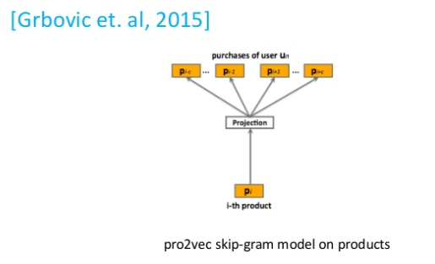
Deep Learning in RecoSys
Product2Vec (input: products purchased in one basked, context: other baskets)
Bundled items
Co-evolving features
User/item interaction evolves over time
Feature vectors are learned by RNN
Session based recommendations
YouTube binge watch sessions
Amazon’s problem as mentioned earlier
GRU4Rec
Notes:
https://www.slideshare.net/kerveros99/deep-learning-for-recommender-systems-recsys2017-tutorial

Slide 36

Thank you
Feedback much appreciated ☺
https://tinyurl.com/RSatPyData
A Good read on this topic is James Le’s article: Link
GitHub links: Basics, using SVD, using Deep Learning

